Slide 1



USA
WOMEN IN WORKFORCE
VEDUDE RABIA SÖZKESEN 32182

Slide 2






DATA
USA
Share of women in the workforce
Average years of schooling for women
Total fertility rate: births per woman
Average age of mothers at childbirth by birth order
Marriage rates

Slide 3



HYPOTHESIS
Null Hypothesis(H0): There is no correlation between any of the 4 datasets and women in workforce.
Alternative Hypothesis(H1): There is a pozitive correlation between women in workforce and;
Average years of schooling for women
Average age of mothers at childbirth by birth order
There is a negative correlation between women in workforce and;
Total fertility rate: births per woman
Marriage rates

Slide 4



MOTIVATION
I want to investigate the factors that influence—and are influenced by—women’s participation in the workforce. I believe that understanding these relationships helps us better comprehend today’s world.
Identifying such trends can also guide the development of more strategic approaches to increasing women’s participation in the labor force and ensuring equal access to employment opportunities for all women.

Slide 5

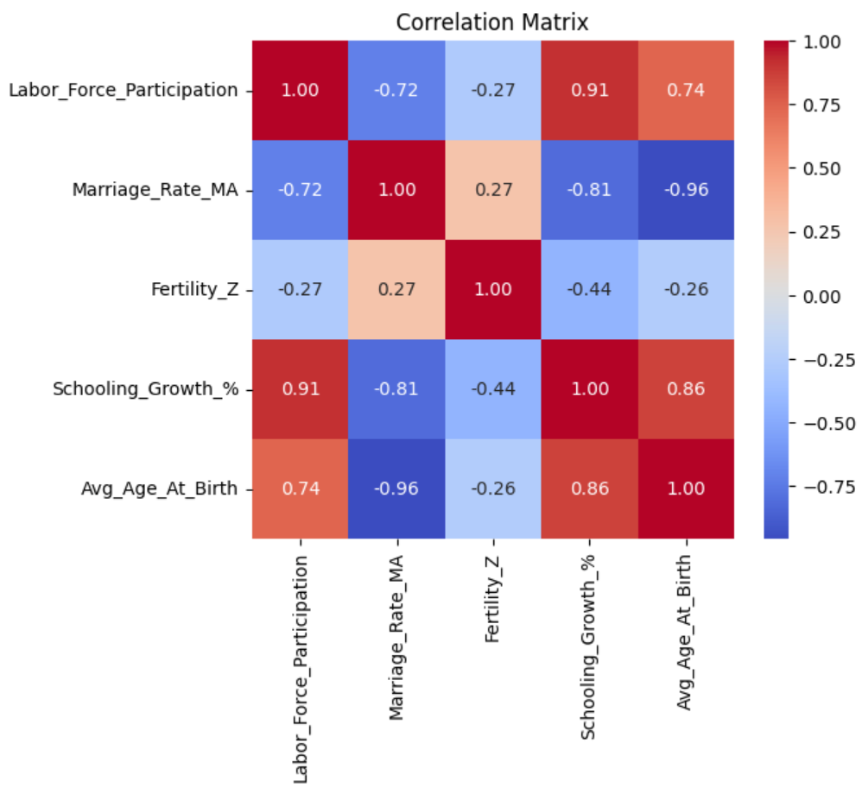
CORRELATION MATRIX
Positive Correlations:
schooling - labor force (strong)
schooling - average age at birth (strong)
average age at birth - labor force (weaker)
Negative Correlations:
marriage rate - average age at birth (strong)
schooling - marriage rate (strong)
marriage rate - labor force (weaker)

Slide 6
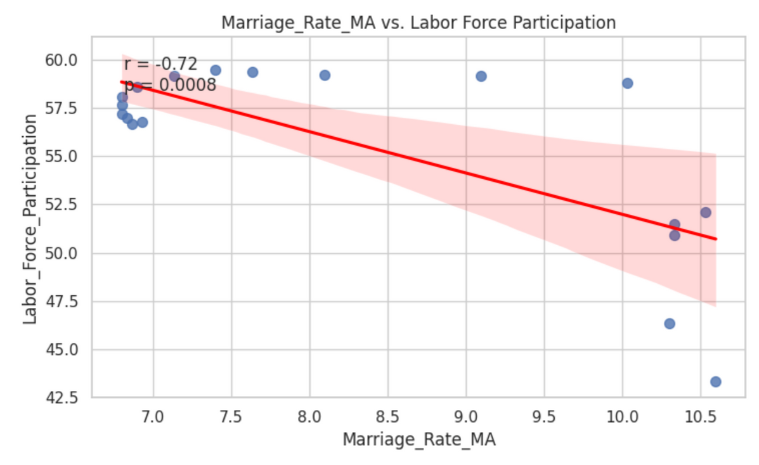
CORRELATION GRAPHS
MARRIAGE AND WORKFORCE
Values:
r = -0.72, p = 0.0008 (significant)
Interpretation:
There is a moderate negative correlation between marriage rates and the number of women in the workforce, suggesting that women who work may be less likely to get married.

Slide 7
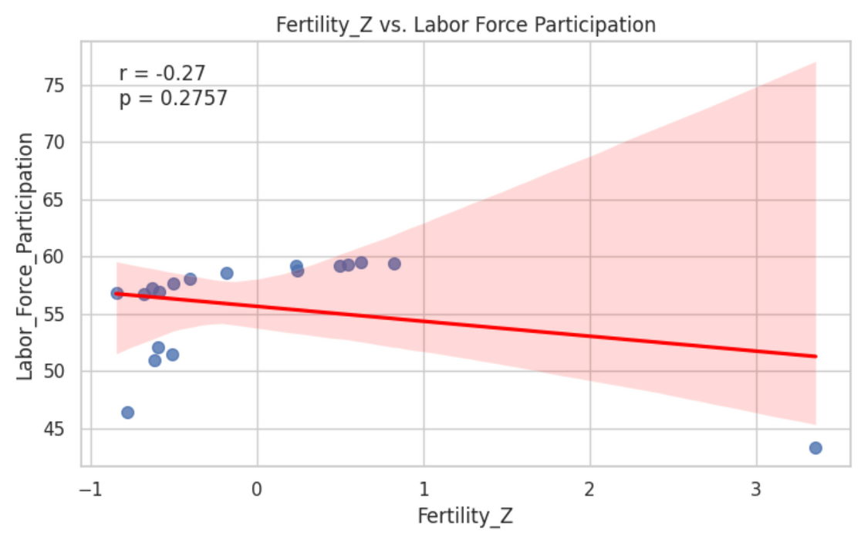
CORRELATION GRAPHS
FERTILITY AND WORKFORCE
Values:
r = -0.27, p = 0.2757 (not significant)
Interpretation:
There is a very weak and negligible negative correlation, suggesting that working women’s decision to have children may not be strongly influenced by their employment status.

Slide 8
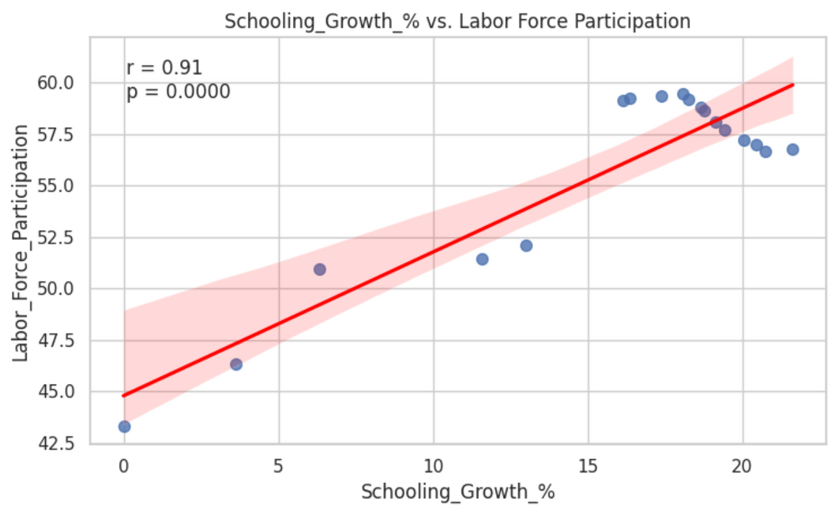
CORRELATION GRAPHS
SCHOOLING AND WORKFORCE
Values:
r = 0.91, p = 0.0000 (significant)
Interpretation:
There is a strong positive correlation between women's education levels and their participation in the labor force, which may indicate that educated women are more likely to be employed.

Slide 9
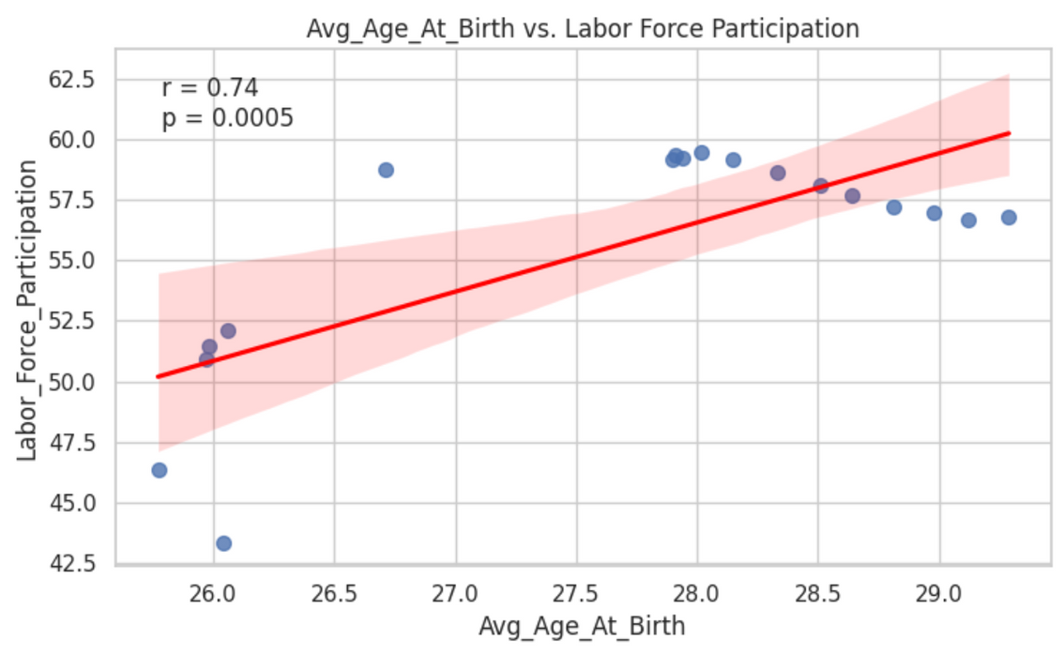
CORRELATION GRAPHS
AGE AT BIRTH AND WORKFORCE
Values:
r = 0.74, p = 0.0005 (significant)
Interpretation:
There is a moderate positive correlation between the average age of mothers at childbirth and the number of women in the workforce, which may indicate that as women participate more in the labor force, they tend to have children at older ages.

Slide 10
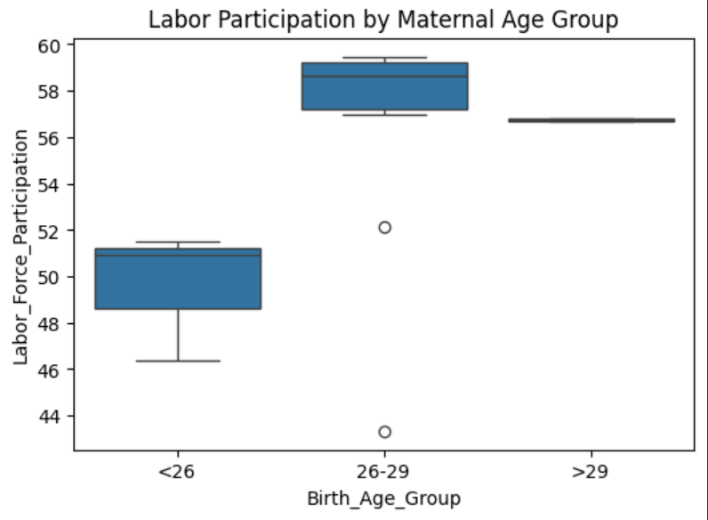
CORRELATION GRAPHS
AGE AT BIRTH AND WORKFORCE
Interpretation:
This boxplot shows that women who give birth at older ages tend to have higher and more consistent labor-force participation. Labor participation is lowest for those under 26, and highest for those giving birth between 26–29 or after 29. This suggests a positive relationship between delayed childbirth and workforce involvement.

Slide 11

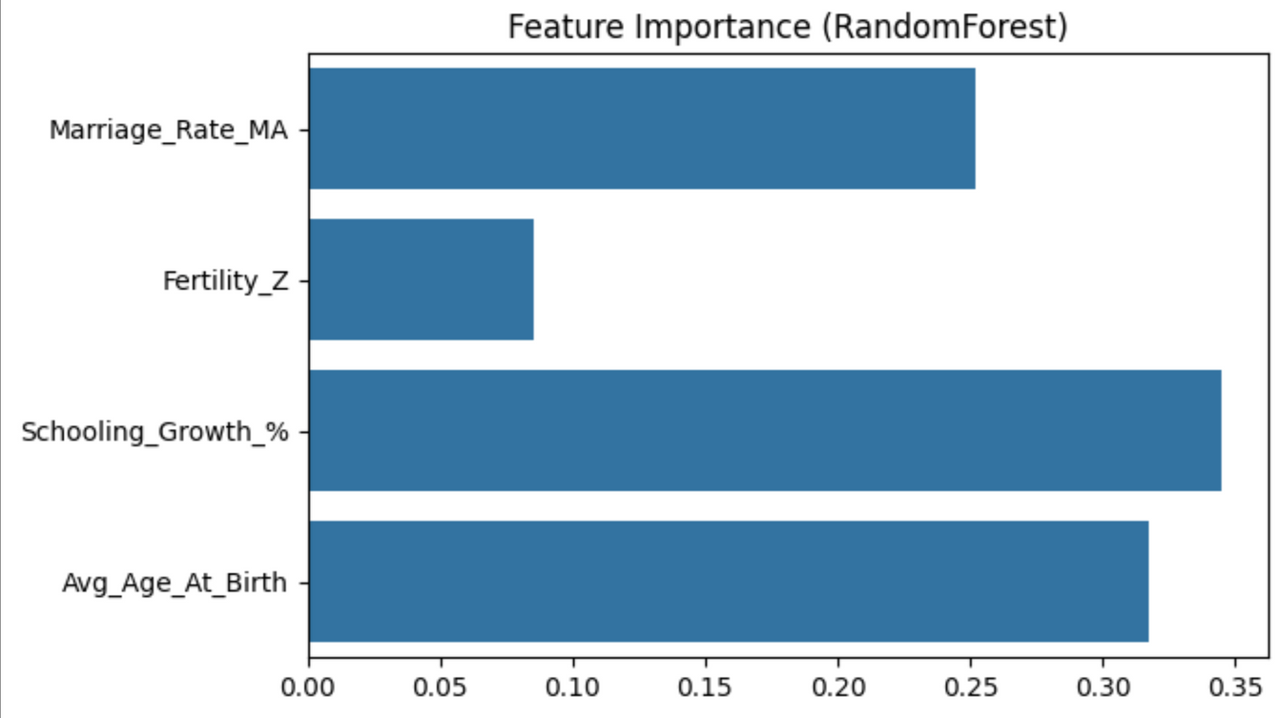
RANDOM FOREST REGRESSION ANALYSIS
The Random Forest Regressor identified Schooling Growth (%) as the most important predictor of female labor-force participation (0.34), followed by Average Age at Birth (0.31) and Marriage Rate (3-year Moving Avarage) (0.25).
Fertility Rate (z-score)
had the lowest importance (0.09), suggesting a minor influence. These results highlight that educational gains and delayed childbirth are strongly linked to higher workforce participation, while fertility changes have less impact.

Slide 12




Data Transformation
Exploratory Data Analysis
Applied a 3-year moving average on marriage rate to reduce short-term noise.
Standardized fertility rate for scale-independence.
Calculated percent growth in women’s schooling over time to show progress.
Binned maternal age into three meaningful age groups for easier group-level analysis.
Visualized relationships using scatter plots with regression lines.
Used seaborn for clean, readable plots.
pearson correlation analysis.
Correlation heatmap to observe variable interactions.
ANALYSIS
EDA AND HYPOTHESIS TESTING
Hypothesis Testing
Data Cleaning & Standardization
Pearson’s r and p-value to assess linear relationships and significance
ANOVA for categorical group comparisons.
Renamed long or inconsistent column names for clarity.
Located the correct schooling column.

Slide 13

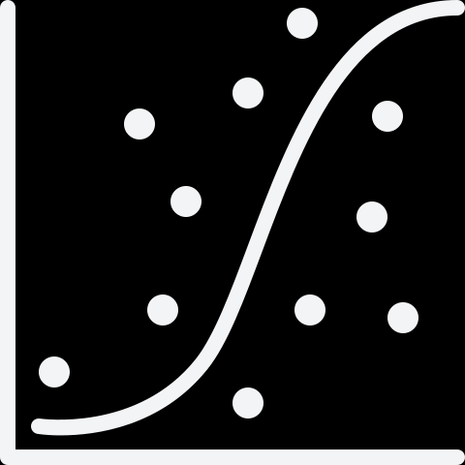

Random Forest Regressor
Support Vector Regression
ANALYSIS
An ensemble-based tree model that builds multiple decision trees and averages their outputs.
Tuned with GridSearchCV on parameters:
n_estimators (number of trees)
max_depth (maximum depth of each tree)
A kernel-based regression method for capturing both linear and non-linear relationships.
Tuned with GridSearchCV on parameters:
kernel (rbf or linear)
C (regularization strength)
epsilon (margin of tolerance)
ML METHODS

Slide 14



FUTURE IMPROVEMENTS
The analysis
can be expanded
beyond the U.S. to
include other regions, allowing comparisons across countries. Interpreting the data by both time and location can reveal how trends vary across different contexts.
Since the data
spans many years,
the correlations can
be analyzed in relation
to historical events that
occurred during those periods.

